Slide 1
Chapter 17b
CSE 3442
Tom Rethard

Slide 2
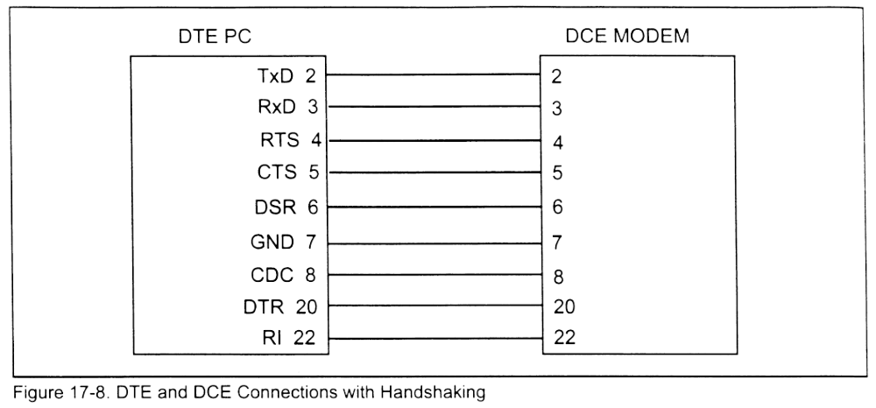
DTE-DCE w/ Handshaking

Slide 3
DCE-DTE Handshaking Lines
DTR – Data Terminal Ready
  Terminal is ready to communicate
DSR – Data Set Ready
  Communication equipment is ready to communicate
RTS – Request to Send
  DTE device has data read to send
CTS – clear to Send
  DCE device is ready to receive data

Slide 4
DCE-DTE Handshaking Lines
CD – Carrier Detect
  Also DCD – Data Carrier Detect
  Asserted by modem to tell DTE that the modem has a valid carrier
RI – Ring Indicator
  Output from modem to DTE when the phone line rings

Slide 5
DCE-DTE Handshaking Lines
Typical sequence
  DTR and DSR inform the terminal and modem that the connection between them is good.
  When DTE has data to send, it raises RTS
  When RTS is raised, the modem raises CTS if it has room to receive the data; if CTS is not raised within a set period of time, the DTE clears RTS and tries again
  When CTS is raised, the data is sent out on TxD
Sequence is similar when the modem has data to send to the DTE

Slide 6
COM Ports
Multiple COM ports are available
  Factory default is usually 2 (COM1 and COM2)
  Internal modems often add a third port
  Additional ports can be added through additional adapter cards

Slide 7
COM Ports
Can be programmed directly, but:
  DOS and BIOS provide aids
  BIOS POST
    Locates and tests each COM port
    Writes I/O port addresses to 0040:0000 – 0040:0007
    Note that this only works for the first 4 ports!
  DOS INT 14H
    Handles serial communication
  DOS MODE command
    Sets initial comm parameters for a port

Slide 8
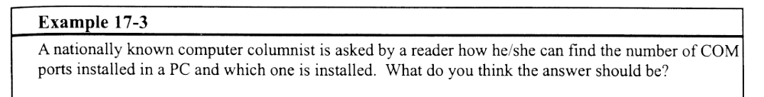
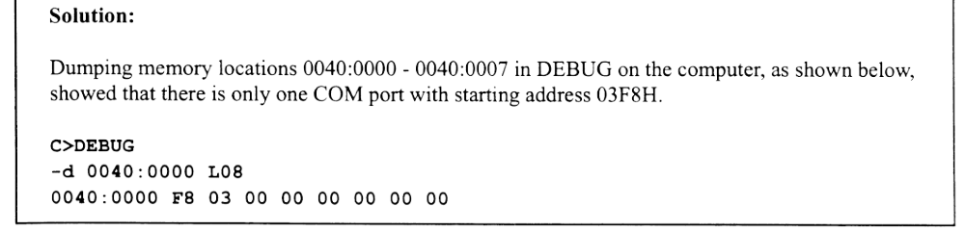
Example 17-3

Slide 9
DOS MODE Command
MODE COMm:b,p,d,s
  M – port number
  b – baud rate
    11,15,30,60,12,24,48,96,19,…
  p – parity
    N, O, E
  d – data bits
    5, 6, 7, 8
  s – stop bits
    1,2

Slide 10
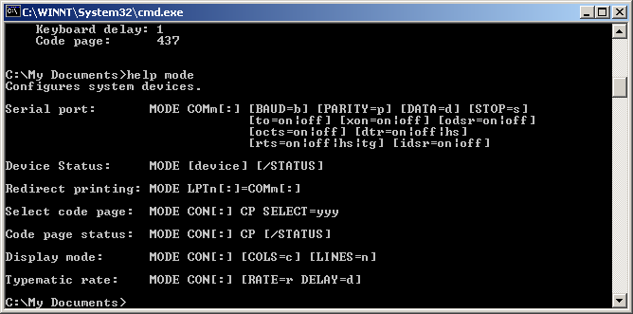
DOS MODE Command

Slide 11
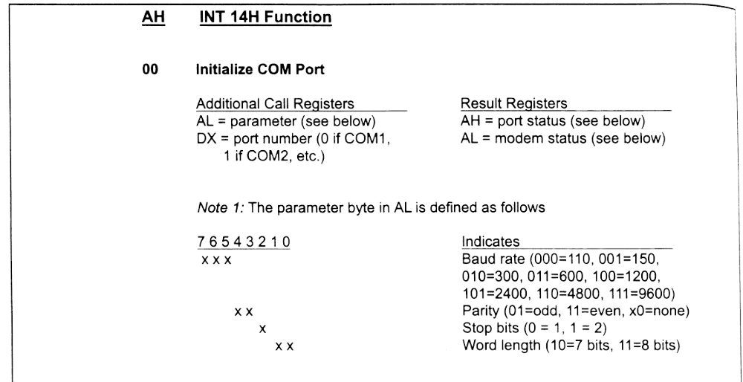
INT 14H Function

Slide 12
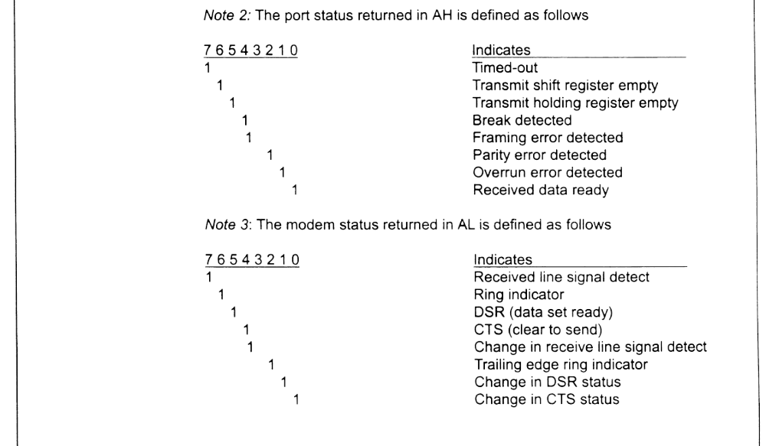
INT 14H Function

Slide 13
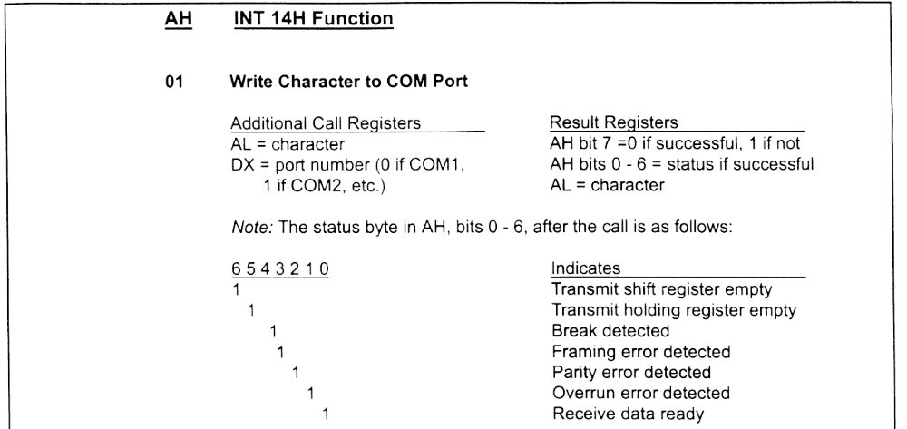
INT 14H Function

Slide 14
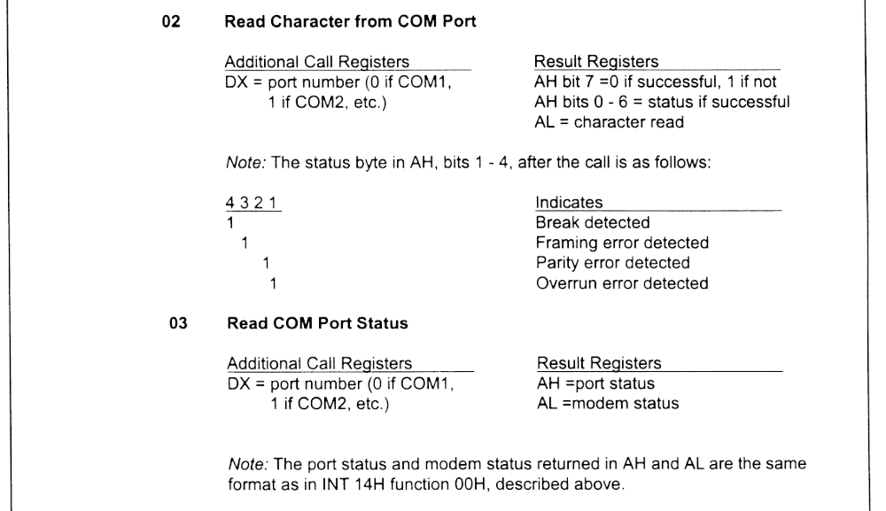
INT 14H Function

Slide 15
PC-to-PC Communication
To send
  INT 14H, AH=1, AL=data character
To receive
  INT 14H, AH=3 to get status of port into AH
  Check D0 of status port (Received Data Ready).
  If RDR is high, then use INT 14H, AH=2 to place the character into AL

Slide 16
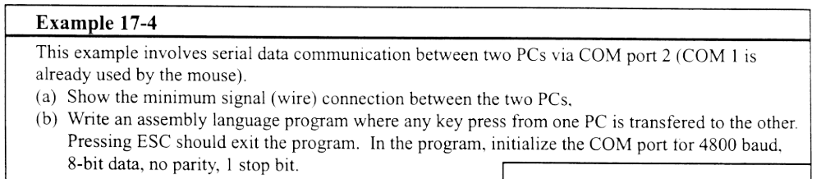
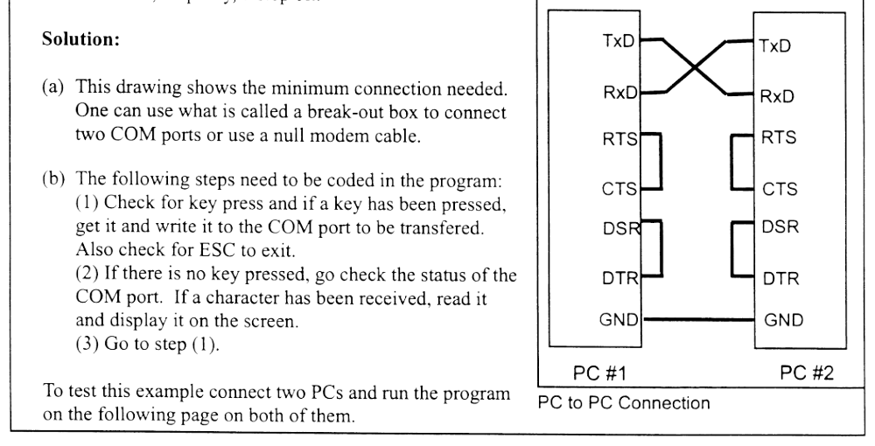
DTE-to-DTE Communication

Slide 17
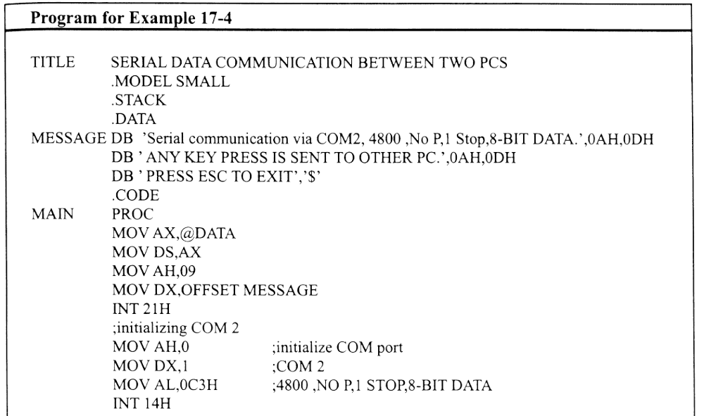
Example 17-4

Slide 18
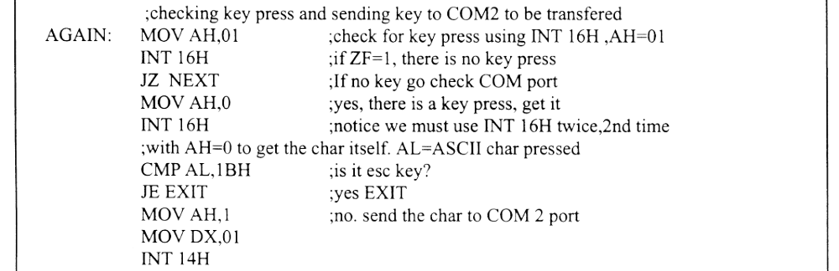
Example 17-4

Slide 19
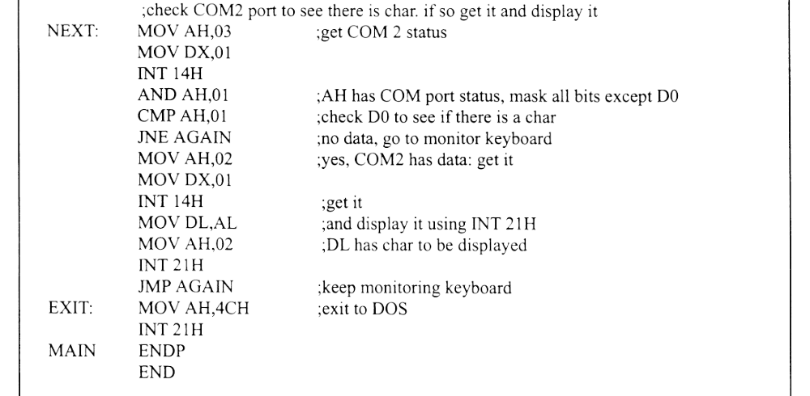
Example 17-4

Slide 20
Interfacing the NS8250/16450
16450 is a later replacement for the 8250 series (pin compatible)

Slide 21
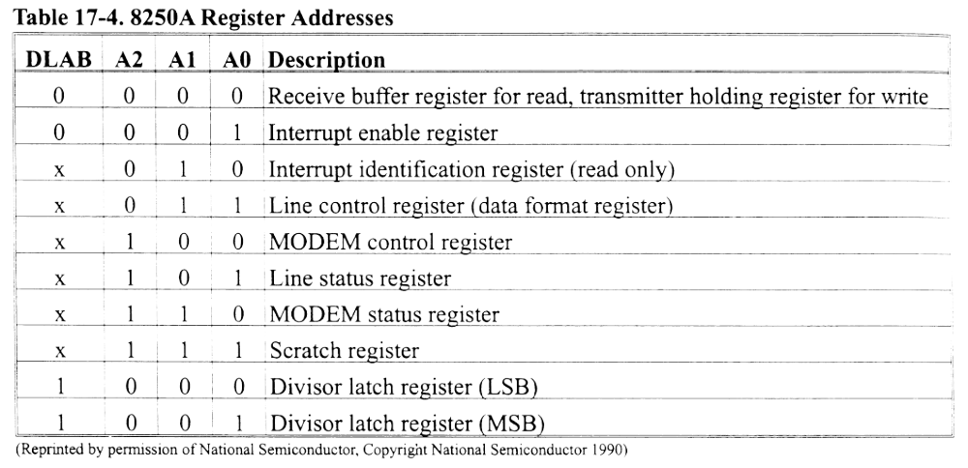
8250A Register Addresses

Slide 22
8250 Pin Descriptions
A0, A1, A2
  Address lines to select the internal register
CS0, CS1, CS2
  Chip selects
  CS2 is actual selection
  CS0 and CS1 are always high
D0-D7
  Data lines

Slide 23
8250 Pin Descriptions
S_{in} and S_{out}
  Serial data in and serial data out
RTS, CTS, DTR, DCD and RI
  Modem signals as before
X_{in} and X_{out}
  Clock frequency
  X_{in} uses signal from system crystal at 1.8432 MHx
  X_{out} is ignored

Slide 24
8250 Pin Descriptions
MR
  Master reset – clears everything except receiver buffer, transmitter hold and divisor latches
RCLK
  Receiver clock – input frequency = 16* baud rate clock
BAUDOT
  Optional output with clock = 16*baud rate of transmitter
  Normally connected to RCLK

Slide 25
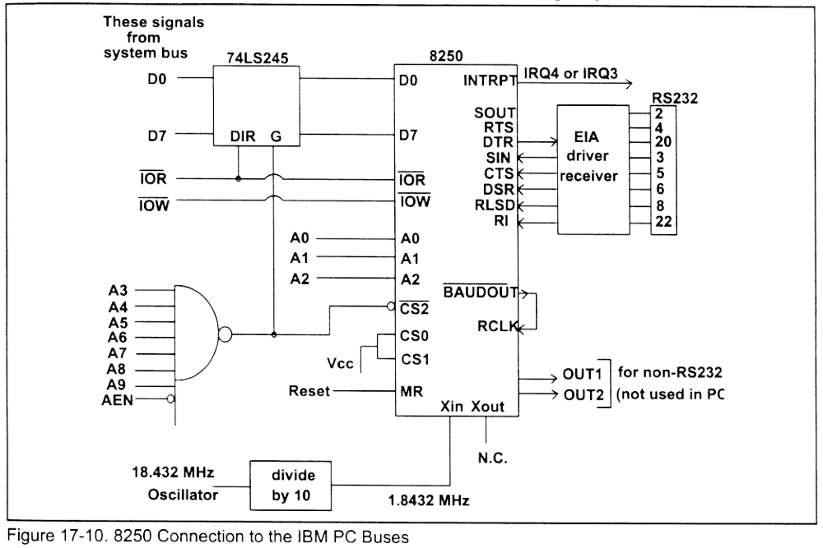
8250 Connection to PC Bus

Slide 26
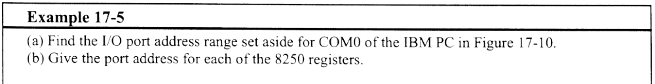
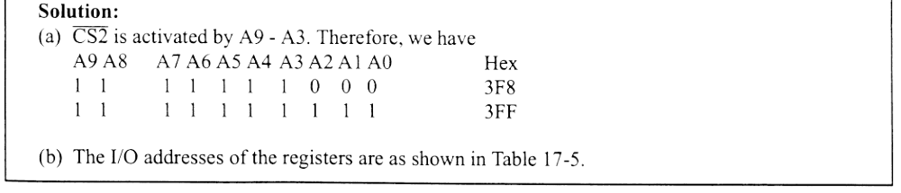
Example 17-5

Slide 27
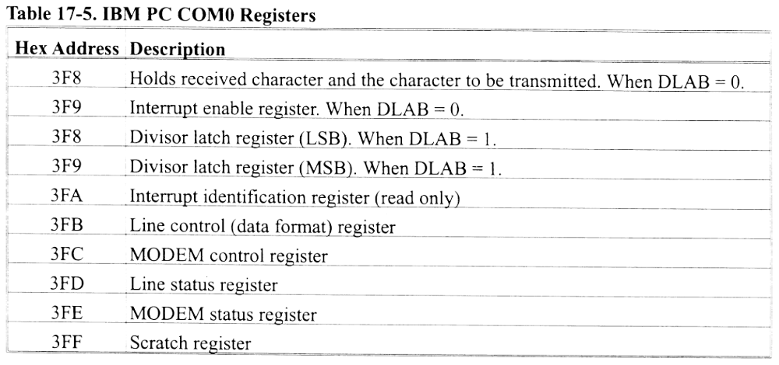
COM 0 Registers

Slide 28
8250 Internal Registers
Transmitter Holding Register
  Source register for data to be serialized
Receiver Buffer Register
  Sink register for data being de-serialized

Slide 29
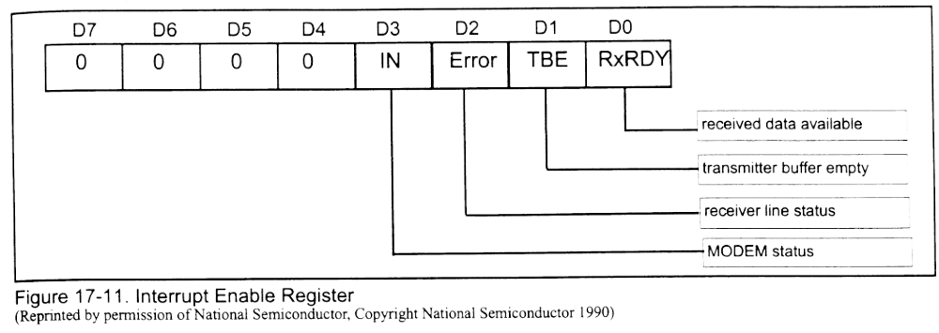
Interrupt Enable Register
Used to notify CPU of certain conditions via hardware interrupt

Slide 30
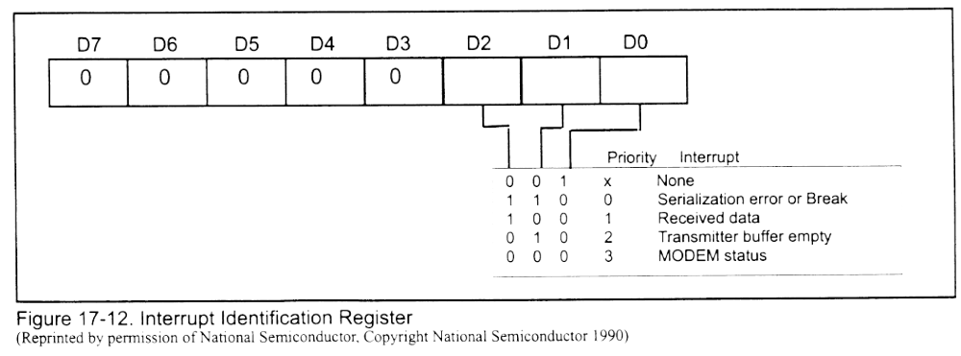
Interrupt Identification Reg.
Contains identification of interrupt cause

Slide 31
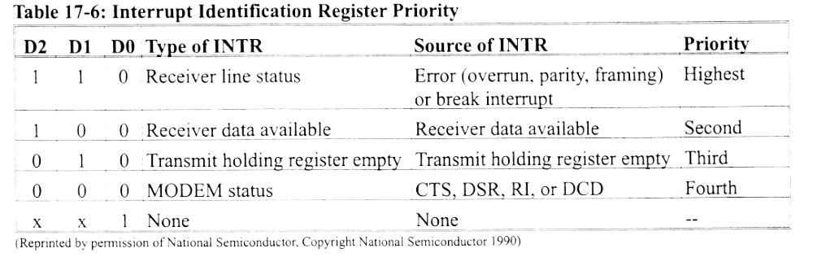
Interrupt Id Reg Priority

Slide 32
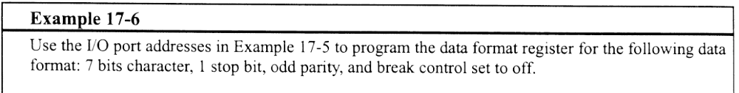
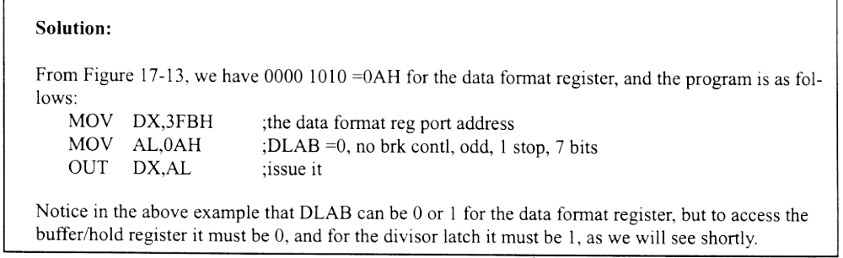
Example 17-6

Slide 33
Line Control Register
Contains the framing information for the transmission

Slide 34
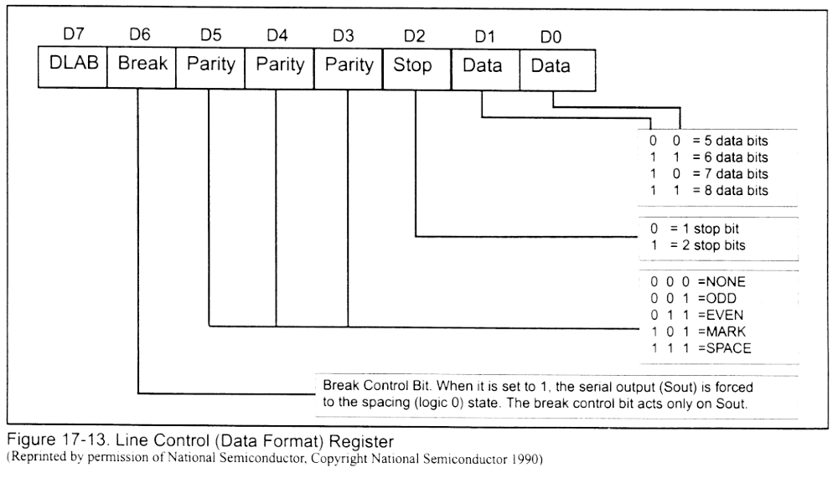
Line Control Register

Slide 35
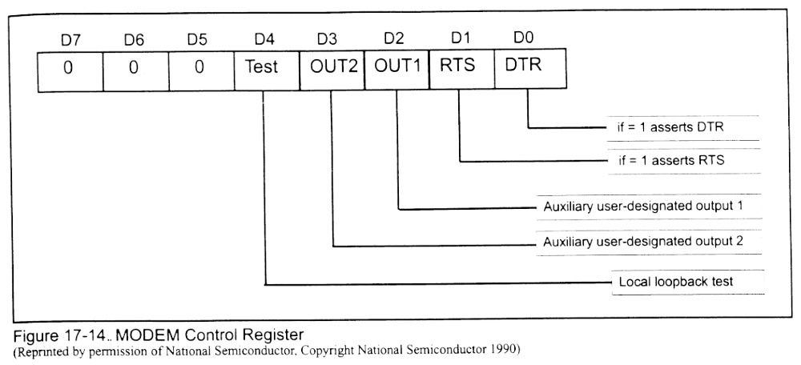
Modem Control Register
Asserts the DTS and RTS pins
Handles loopback tests

Slide 36
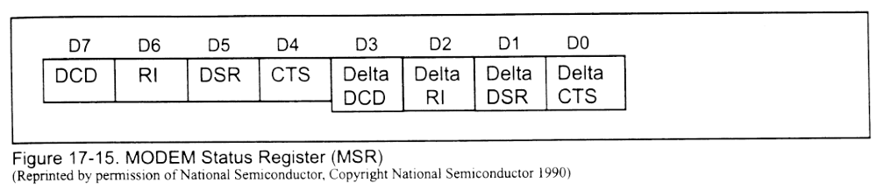
Modem Status Register
Also called RS232 status register
Current status of modem control line
Same as modem status byte returned by INT 14H

Slide 37
Line Status Register
Identifies errors on the line
Same as port status on return from IN 14H, except that D7 is set to 1 for time-out by the BIOS

Slide 38
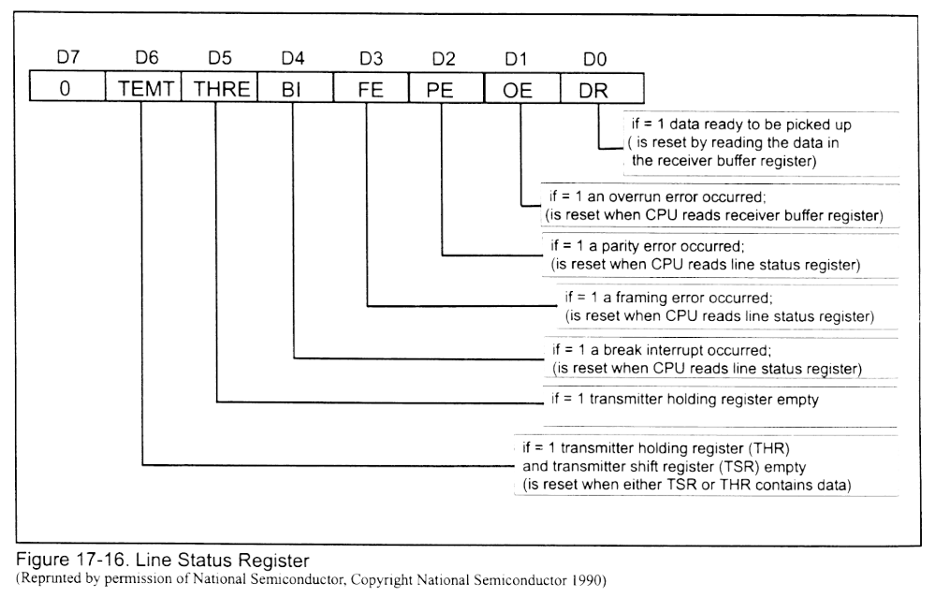
Line Status Register

Slide 39
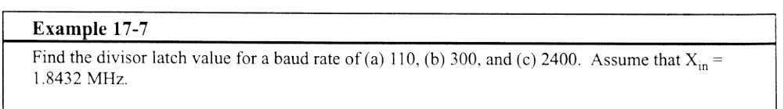
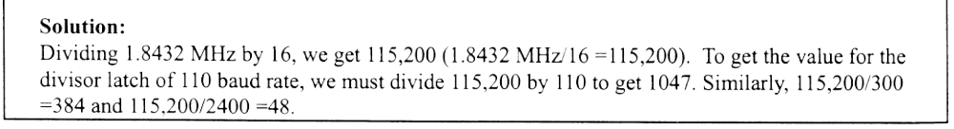
Example 17-7

Slide 40
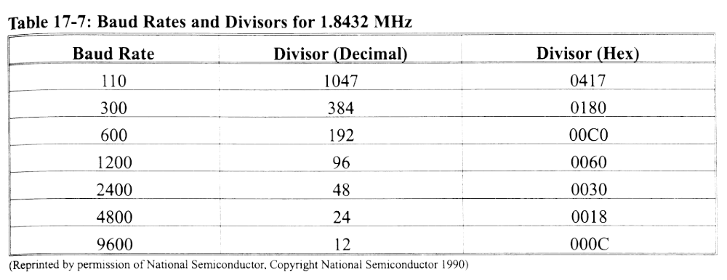
Baud Rates and Divisors

Slide 41
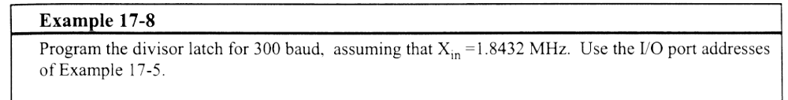
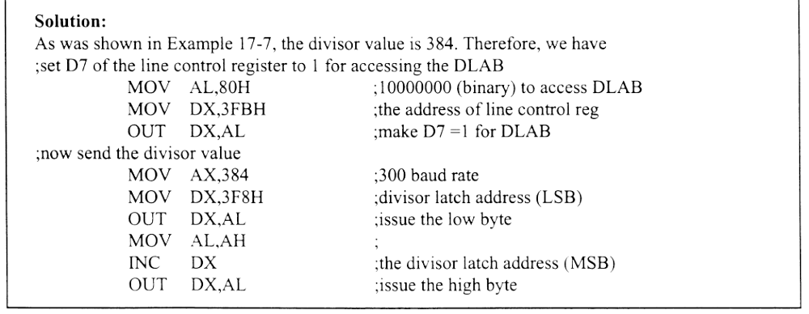
Example 17-8

Slide 42
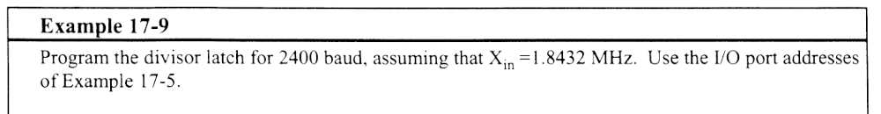
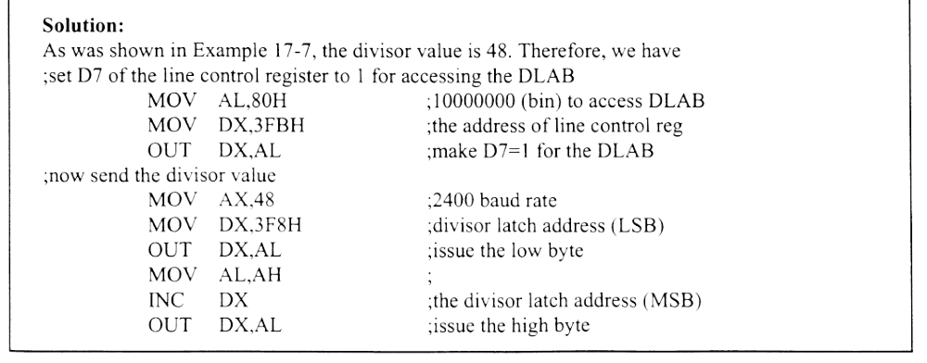
Example 17-9

Slide 43
Scratch Pad Register
Not used by the 8250 and may be used by the CPU
Literally a “scratch pad”

Slide 44
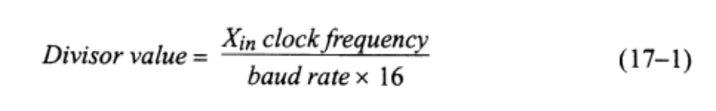
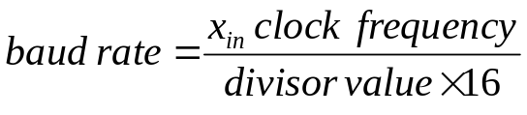
Divisor Latch
LSB and MSB
  For programming baud rate
  Clock is divided by 16-bit contents of Divisor Latch, then by 16 to get appropriate
To determine divisor value
To determine baud rate value

Slide 45
8250 Limitations
Interrupts CPU for each byte received or transmitted
  Use 16550AF, which has a 16 byte buffer, not just 1 and is 8250 compatible

Slide 46
8251 USART
Handles synchronous and asynchronous communications
28 pin chip
Internal registers
  Mode register
  Status register
  Command register

Slide 47
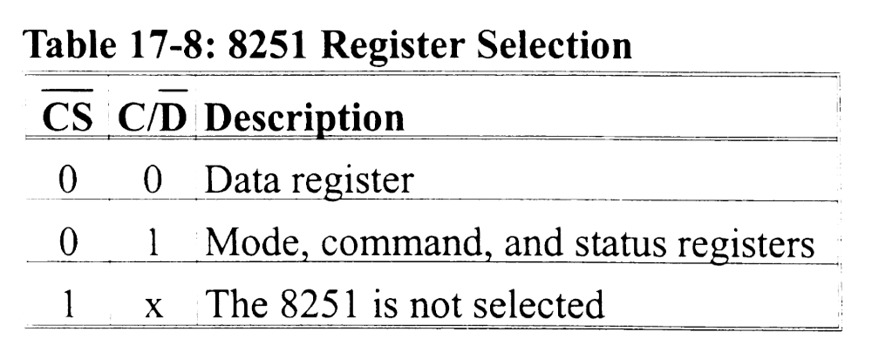
8251 Register Selection

Slide 48
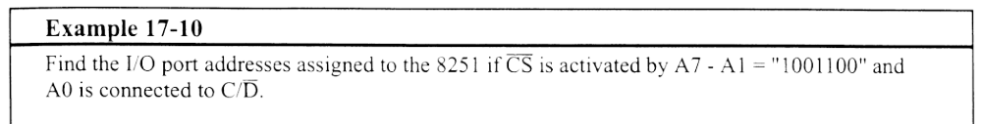
Example 17-10

Slide 49
8251 Baud Rate Selection
TxC and RxC are connected to same frequency
Baud rate selections are x1, x16 and x64
Baud rate selection x 1, 16 or 64 must be equal to clock frequency (TxC or RxC)

Slide 50
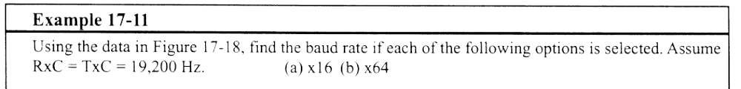
Example 17-11

Slide 51
8251
Mode register and command register are at same address
  Always program mode register first to set data format and baud rate
  Rewriting the register writes to command register
  Must reset before accessing mode register again
Status register is read-only
  See example 17-13, later

Slide 52
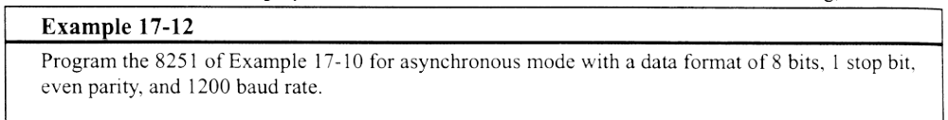
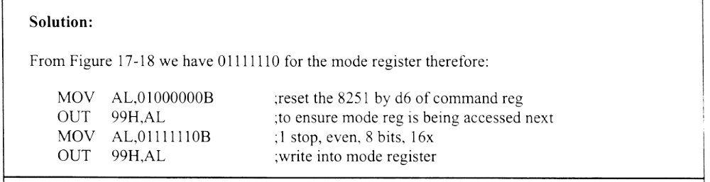
Example 17-12

Slide 53
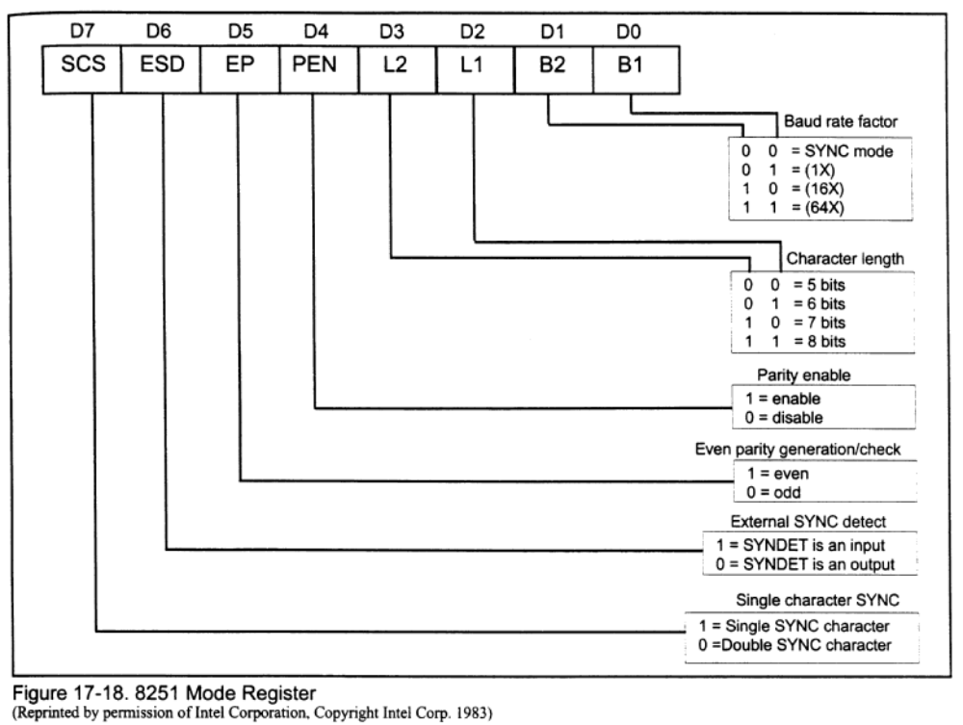
8251 Mode Register

Slide 54
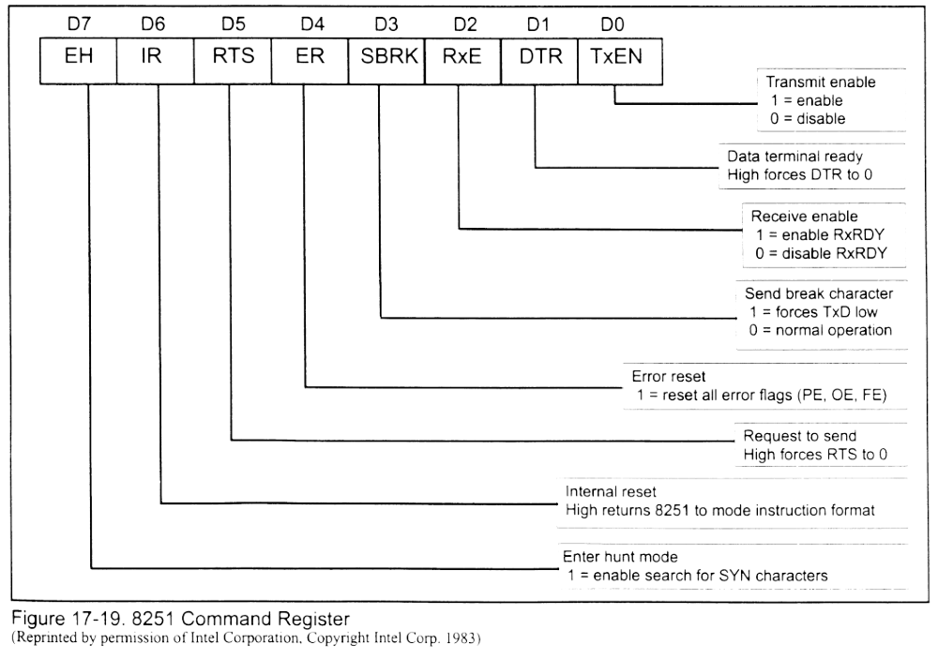
8251 Command Registers

Slide 55
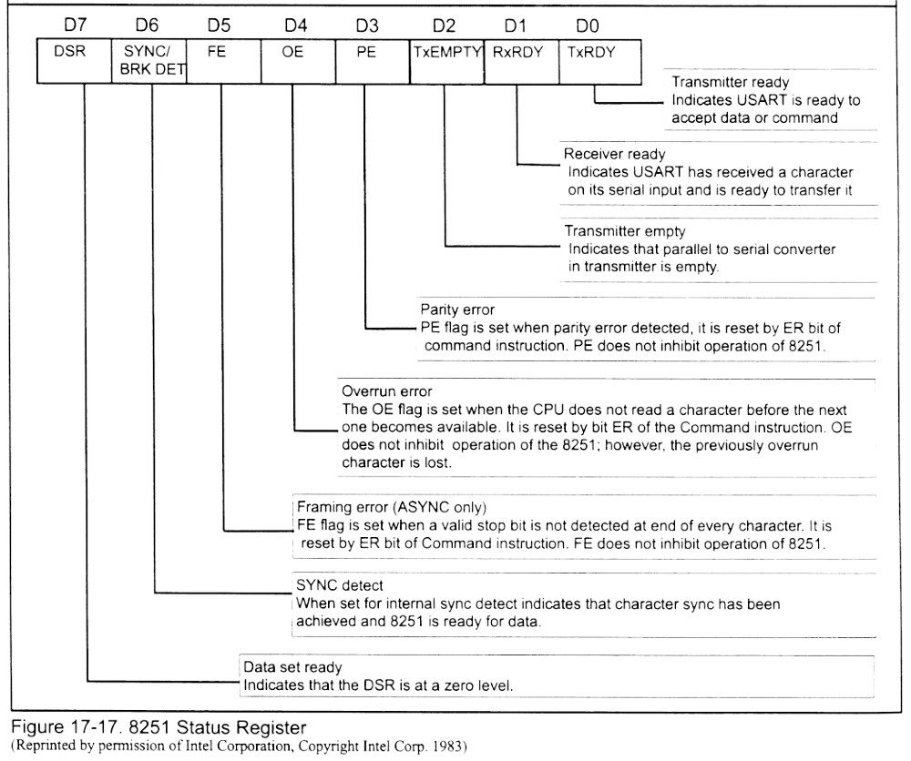
8251 Status Register

Slide 56
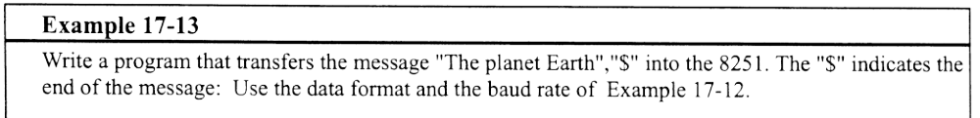
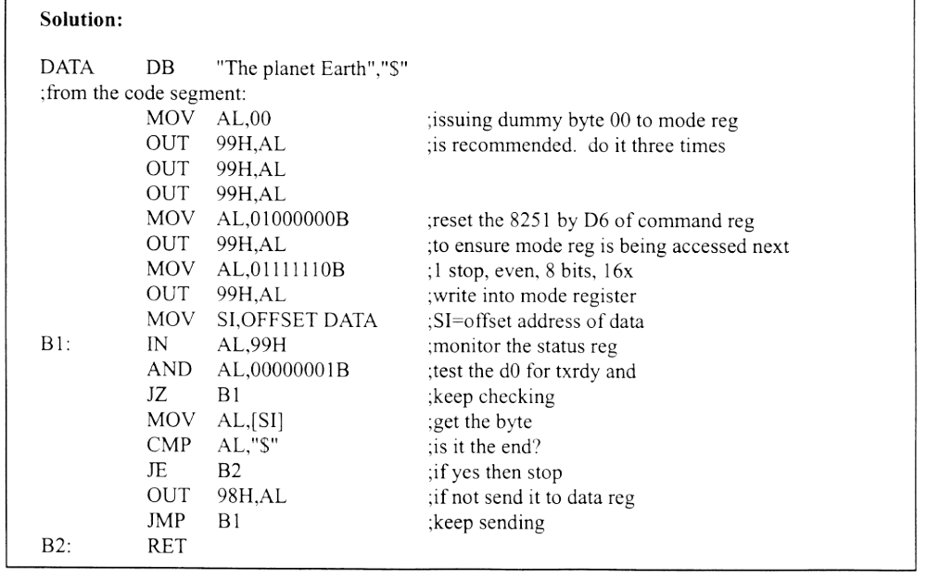
Example 17-13

Slide 57
Synchronous Serial Comm
Overhead in asynch comm can be as much as 50%, so synch comm was developed
Start and stop bits replace with special bytes, and frame contains hundreds of bytes of data
Blocks are framed instead of bytes
Control codes vary by protocol

Slide 58
Synchronous Serial Comm
Most common protocols are BISYNC and SDLC
BISYNC
  No start or stop bytes.
  Each block contain one or more synch characters
  Next is STX (start of text)
  Block of data (can be 100+)
  ETX (end of text)
  Last byte is BCC (Block Check Character)

Slide 59
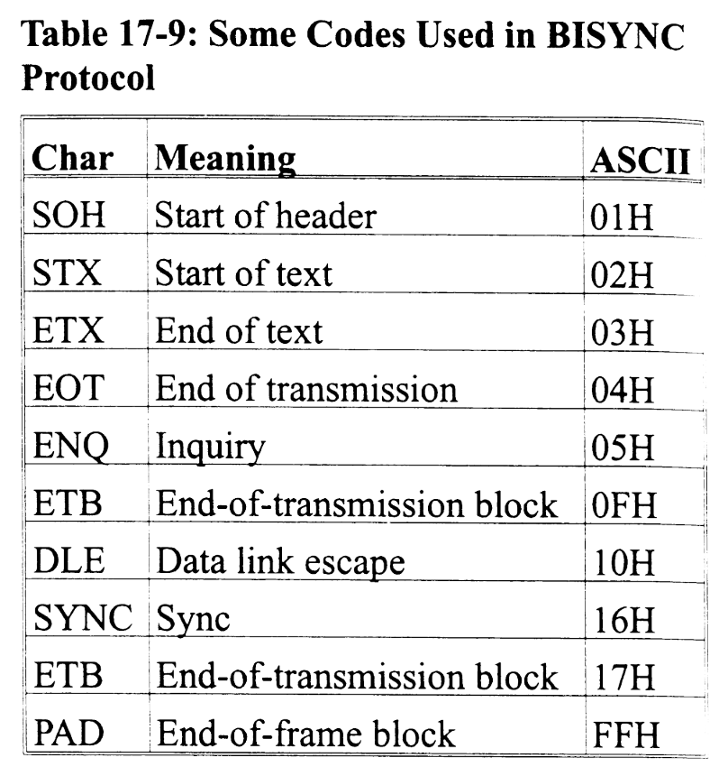
Bisync Codes

Slide 60
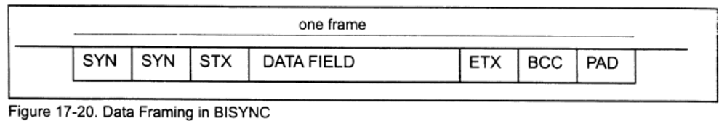
Bisync Framing

Slide 61
Synchronous Data Comm
SDLC
  From IBM
  Use 8-bit pattern 01111110 instead of SYNC byte (called flag byte)
  8 bit destination address
  8 bit control byte (info about sequencing)
  Data (can be 1000s of bits)
  16-bit frame check
  End flag byte (same as start flag byte)

Slide 62
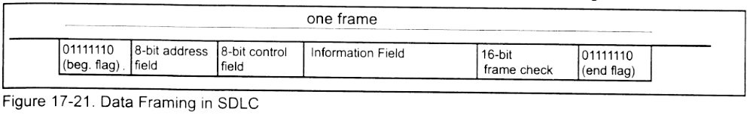
SDLC Framing

Slide 63
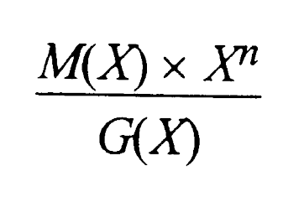
CRC Formula
M(X) – the bit stream
n – number of bits in the stream
G(X) – the generator polynomial
Results:
  Q(X) – the quotient
  R(X) – the remainder: CRC Value

Slide 64

Example 17-4
16 bit data stream, 4D92H
In binary: 0100 1101 1001 0010

Slide 65

Example 17-4
Dividend
  X^30+X^27+X^24+X^23+X^21+X^20+X^17
G(X)
  X^16+X^14+X^5+1 (SDLC)
R(X)
  X^15+X^14+X^12+X^10+X^8+X^7+X^5+X^3+X,
  which gives:

Slide 66
Things to Note
CRC is R(X) in reverse order
Frames are usually long to minimize CRC overhead
The receiver reads the bit stream and the CRC, then divides by G(X)
  A result of 0 indicates all ok
  A non-0 result indicates an error

